Slide 1
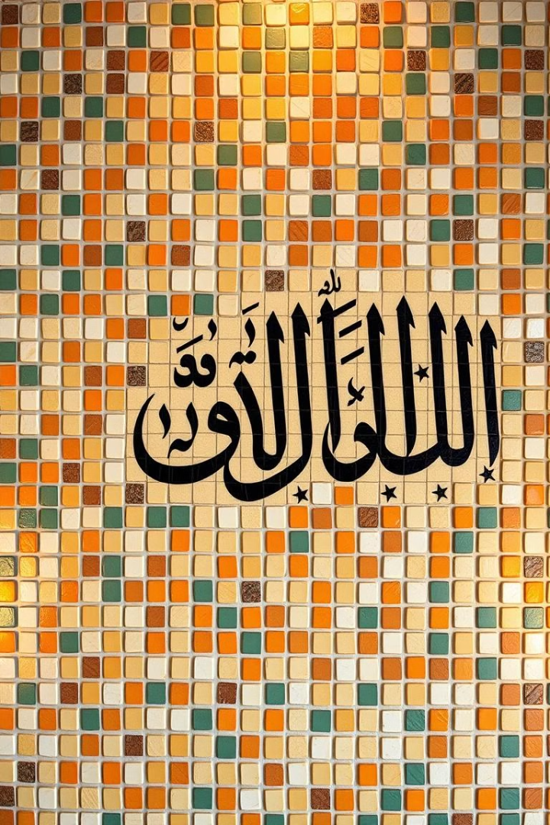

Unlocking the World of Arabic: A Journey Begins
Welcome to this introductory module on the Arabic language and script. Let's explore its history, unique features, and the reasons why learning Arabic is an enriching journey.
par Arij Labidi

Slide 2
A Glimpse into the Arabic Language
Ancient Roots
The Quran
Arabic, a Semitic language with deep roots, holds a prominent place in history and culture. Its influence extends far beyond the Arab world.
As the language of the Quran, it plays a central role in Islamic faith and practice. It is a language that connects millions of people around the globe.

Slide 3
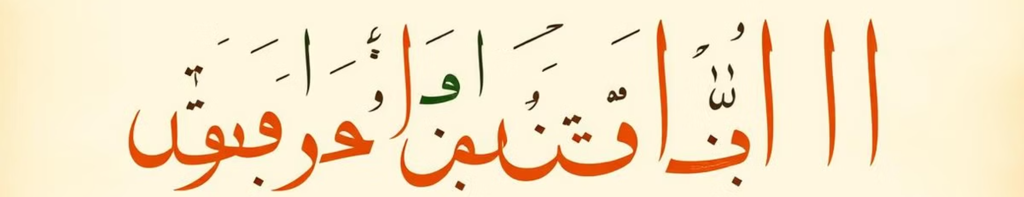
What Makes Arabic Unique?
1
Right-to-Left Script
2
Connected Letters
3
Vowel System
Arabic is written from right to left, making it a unique script among world languages.
Arabic letters connect to each other, creating fluid, elegant words. The shape of each letter changes depending on its position in a word.
Arabic uses diacritical marks, called "harakat," to indicate short vowels in writing.

Slide 4




Motives for Learning Arabic
Personal Growth
Discover the rich heritage and cultural traditions of the Arab world. Explore the literature, music, and art that shape this vibrant region.
Professional Opportunities
Open doors to careers in translation, international business, education, and diplomacy.
Cultural Connection
Connect with the people and traditions of 22 Arab-speaking countries. Build meaningful relationships and broaden your understanding of the world.

Slide 5

Ready to Begin Your Arabic Journey?
You've taken the first step towards understanding the beauty and depth of Arabic. This module has equipped you with a solid foundation.
Now, embark on your exciting journey of learning the Arabic alphabet in the next module!

